Slide 1
Restaurant Risk Classification
Anvesh Kollu Reddi Gari
Sai Shashanka Suryadevara
Santosh Molgu
Rajiv Nandan Sagi

Slide 2
Trend Number based on Inspection Reasons and Results
Standardized no. of inspections to minimize the impact of high inspections for certain restaurants
Calculated percentage of each type of results out of total results for that restaurant to compare for all restaurants on same scale
Assigned different weights and calculated the score

Slide 3
Trend Number based on Inspection Reasons and Results
Weight | Attribute
4 | Complaint Full
2.5 | Complaint Partial
0.75 | Food-Licensing Inspection
1 | Routine - Food
1 | Routine - Lodging
1 | NoInspec
6 | Facility Temporarily Closed
3 | Follow-up Inspection Required
-1 | Met Inspection Standards

Slide 4
Trend Number based No. of Infractions
Standardized no. of inspections, violations and Calculated No. of Violations/Infractions to minimize the impact of high inspections for certain restaurants
Calculated percentage of each type of results out of total results for that restaurant to compare for all restaurants on same scale
Assigned different weights and calculated the score

Slide 5
Trend Number based No. of Infractions
Weight | Attribute
-0.1 | No of Inspections
6 | High Infraction
3 | Intermediate infraction
1 | Basic Infraction
1 | When Core Item is True
1 | When Priority found item is True
0.5 | When Priority found item is False
0.5 | When Core Item is false
1 | When Priority item is True
0.5 | When Critical is False
0.5 | When Priority item is False
1 | No of violations
3 | When Critical is True
0.25 | When Corrected OnSite is True
1.25 | When Corrected OnSite is False
2 | When Repeat Violation is True
1 | When Repeat Violation is False
1.5 | No of violations per inspecion

Slide 6
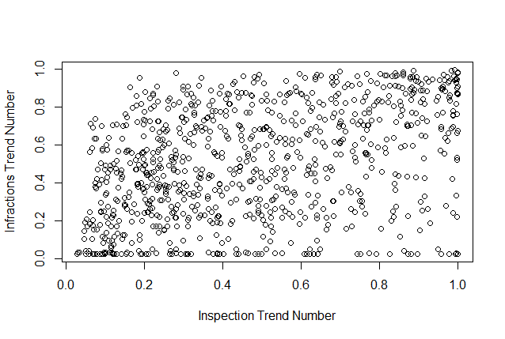
Correlation of two trend numbers
Correlation obtained = 0.404
Correlation Plot:

Slide 7
Correlation of two trend numbers
Both these trends numbers are uncorrelated this is also supported by T-Test.(p-value = 0.0432)
These two numbers doesn’t lead to a single index.

Slide 8
Scanning key words from inspection detail
Methodology for identifying key words associated with violation types
Represent each comment as a matrix of n-grams (bag of words)
Apply TF-IDF as a weighting factor in identifying importance of n-grams
Build a linear support vector machine (SVM) model against the violation category
Identify key n-grams associated with each category of violation based on the weight of the coefficients
Plot the features in word cloud

Slide 9
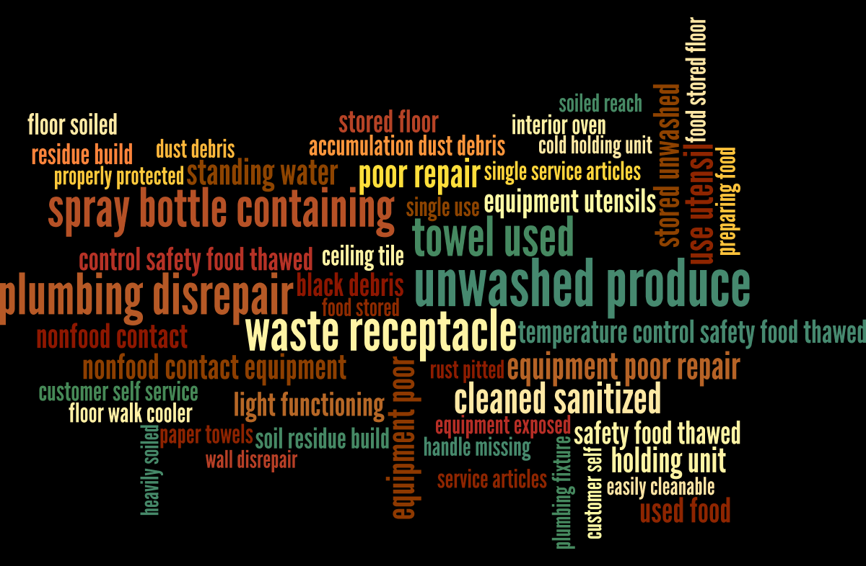
Basic Violations

Slide 10
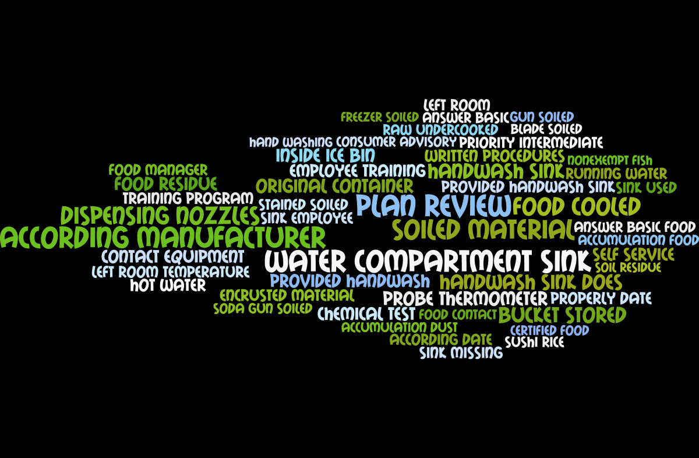
Intermediate Violations

Slide 11
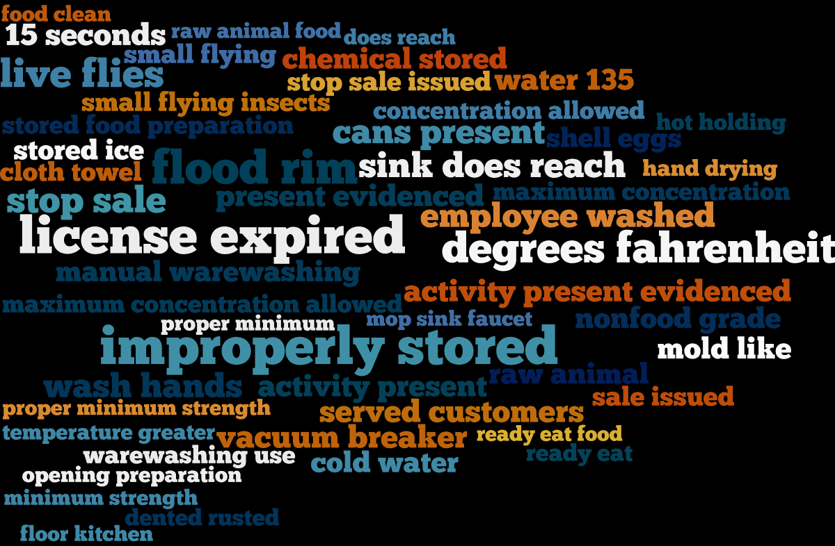
High Priority Violation

Slide 12
Appendix
List of features and weights for each violation type -

